Slide 1

Death Note VM
Logan Davenport - 11/7/2023

Slide 2

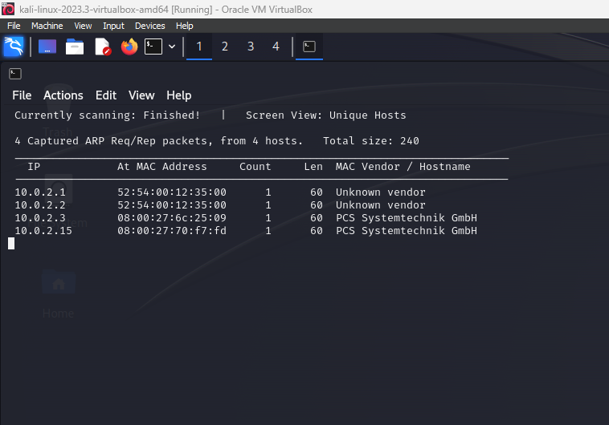
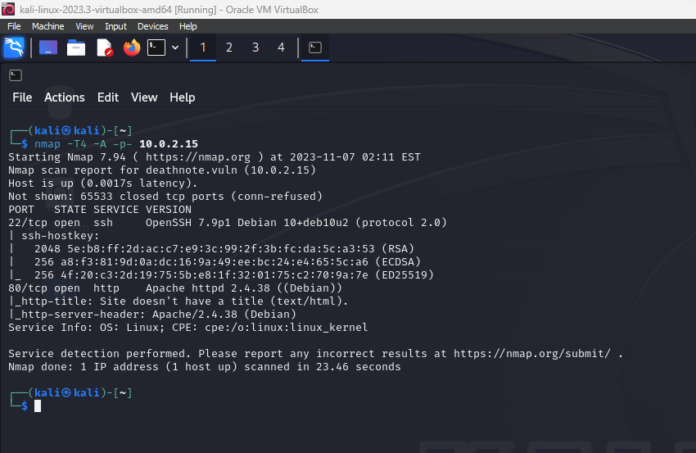
In step one I used Sudo netdiscover -r 10.0.2.0/24 to scan for the targets IP. Once targets IP was identified I used Nmap using –T4 for aggressive scanning, -A for OS and version detection and -p- to scan all ports.
From the scan I was able to find an open SSH port on 22 and an open http port on port 80 which then lead me to a webpage for further investigation.

Slide 3

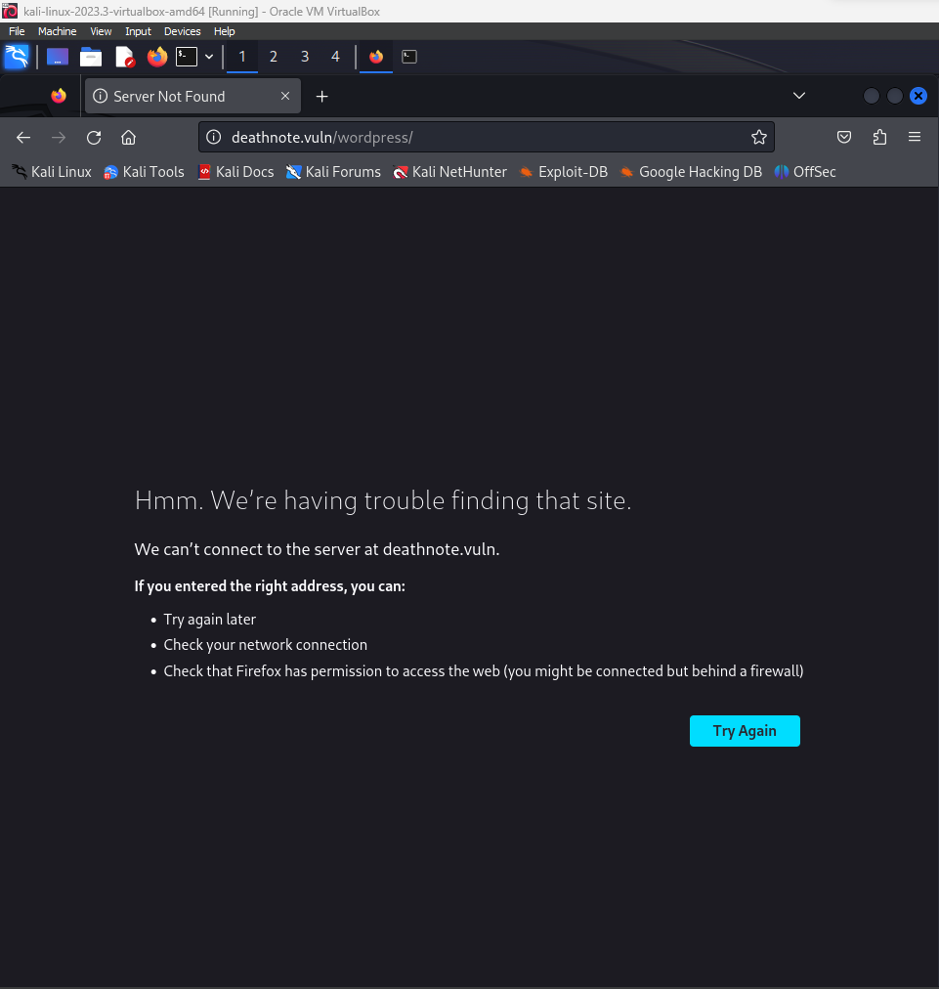
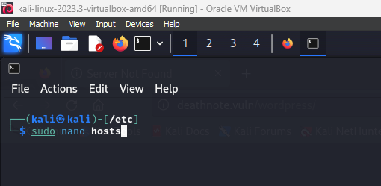
My initial search of the IP brought me to deathnote.vuln which was not allowing me access to the server, so I ran sudo nano hosts and added the IP as well as the domain name to my list of hosts and was successfully granted access to the homepage.

Slide 4
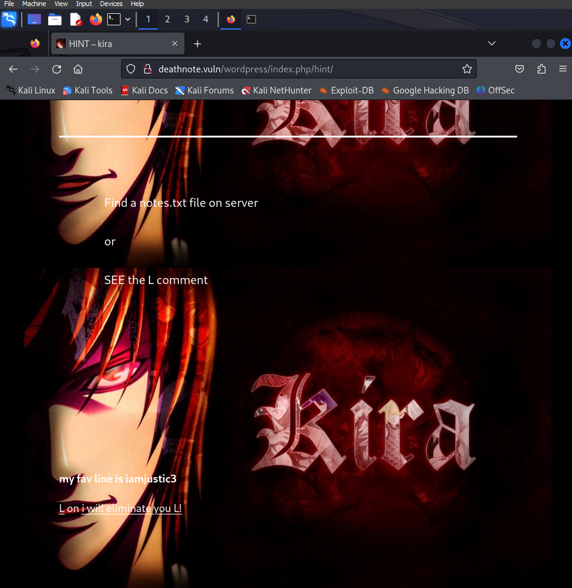
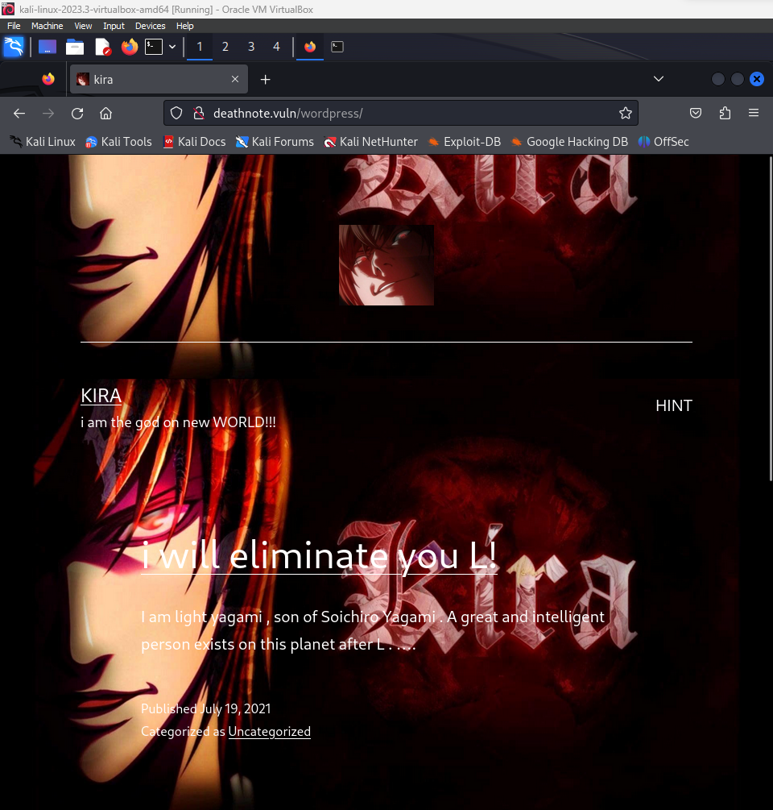
On the homepage a few things stood out like Kira and L being likely usernames as well as the text “my fav line is iamjustic3” pointing to a possible password and a hint saying to look for notes.txt, then the next step would be locating where to put the possible usernames and password to use and locate notes.txt.

Slide 5
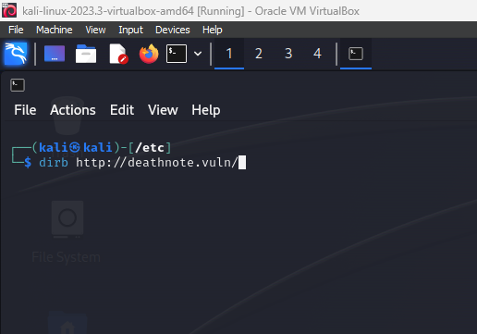
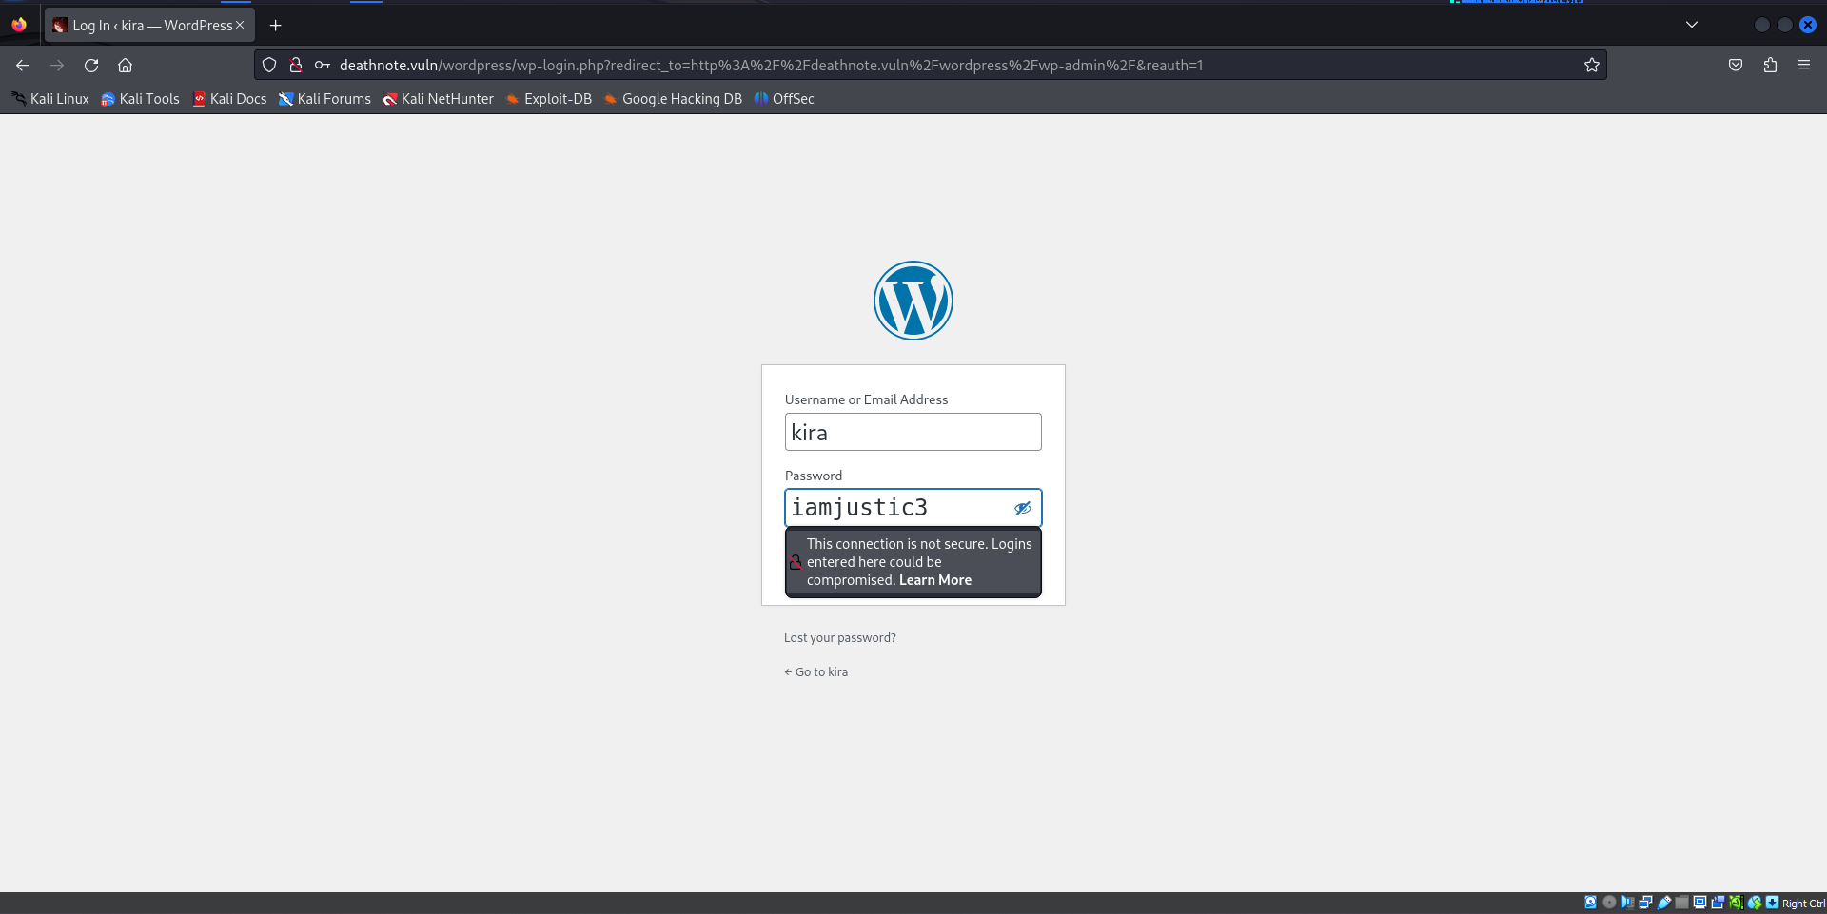
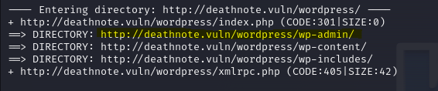
Using Dirb with dirb/wordlists/common.txt I was able to brute force through a lot of directories the most notable being wp-admin which when navigated to provided me with a username and password prompt allowing me to test the possible username and password, found earlier which did end up providing a successful login.

Slide 6
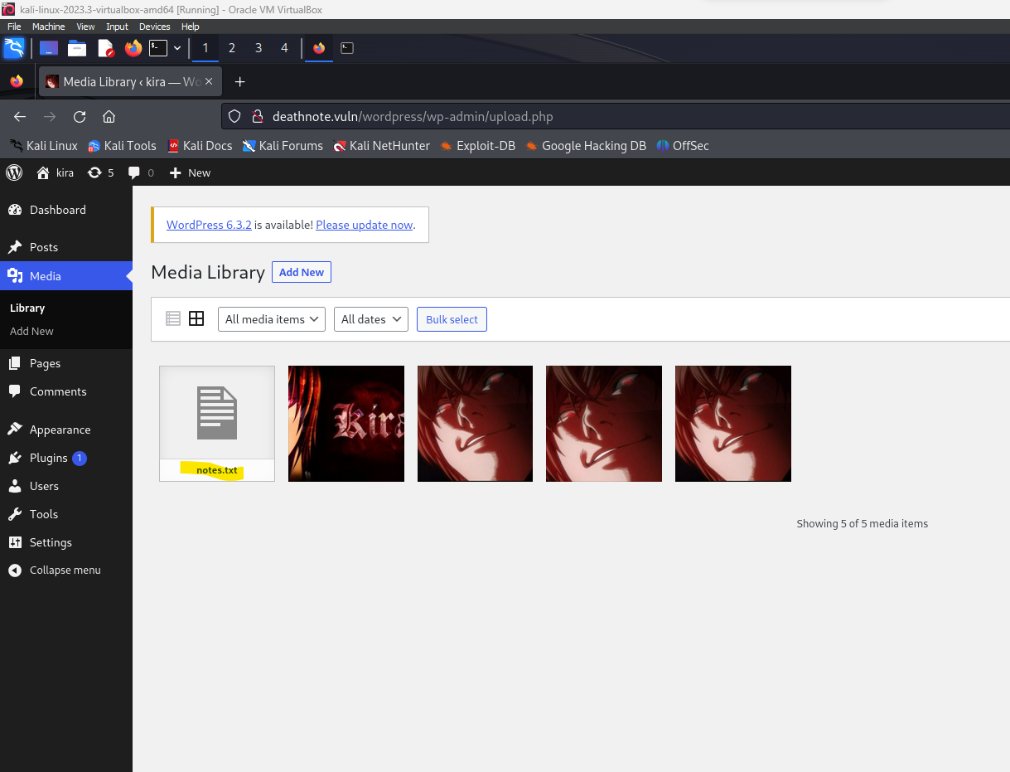
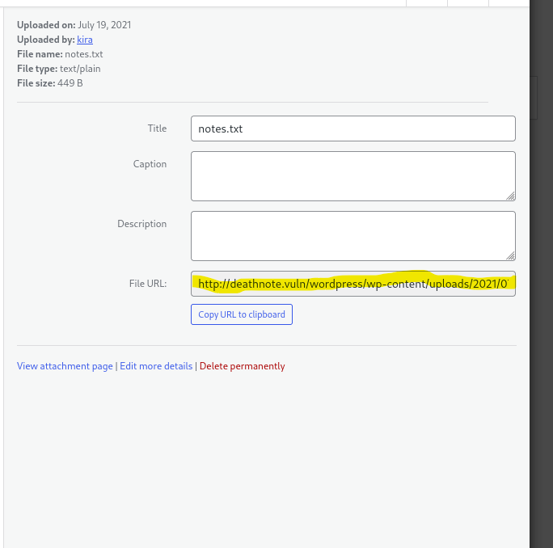
After logging in I was presented with the account dashboard and a navigation toolbar to the left with several settings and several server-side databases, I flipped through a few until I ran across notes.txt from our earlier hint located in the media library.

Slide 7

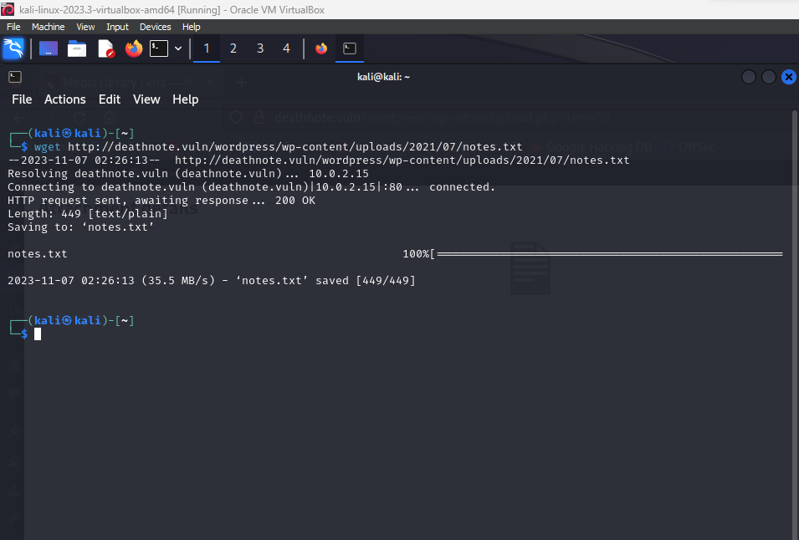
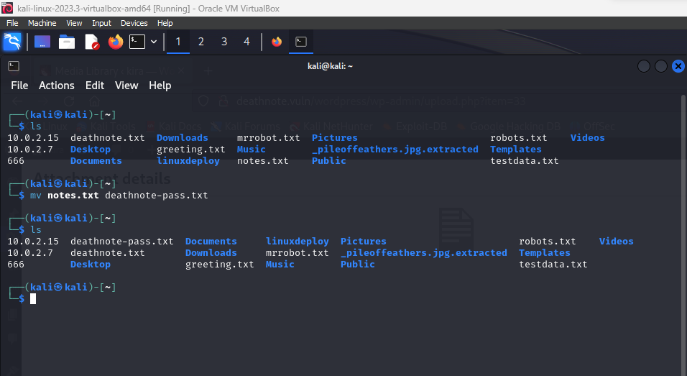
I utilized wget to download notes.txt to my system and cat to read the contents of the file, the result was several texts resembling what would most likely be a list of passwords. I then used mv to rename the file for later use.

Slide 8

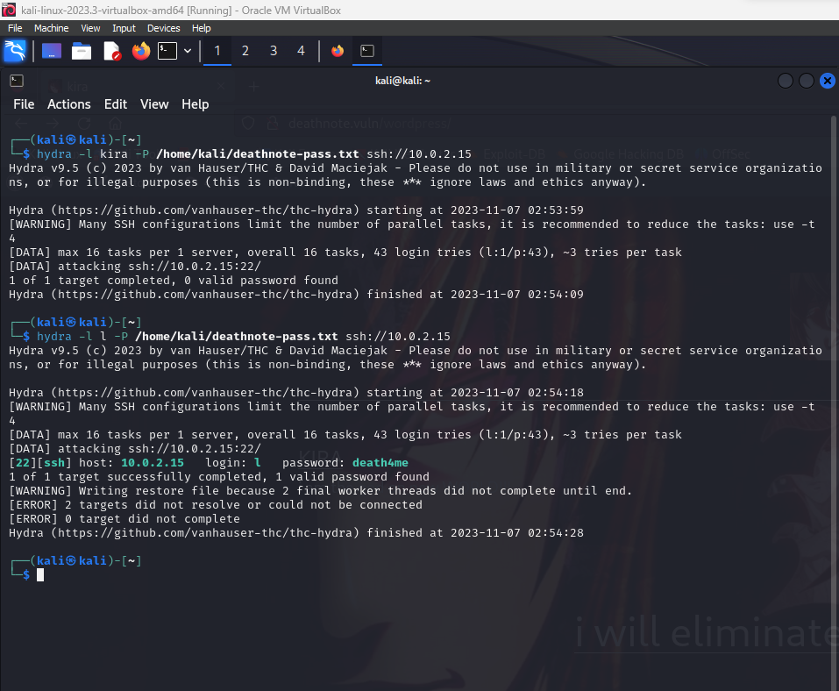
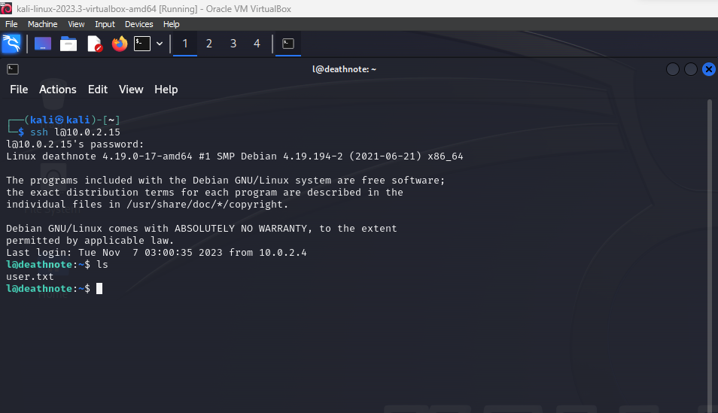
I used hydra to attempt to gain access to SSH using both suspected usernames and using my newly created password list and came up with a match for the SSH login with username l and password death4me, I then applied it with ssh l@{IP} in this case 10.0.2.15 gaining access to the machine.

Slide 9
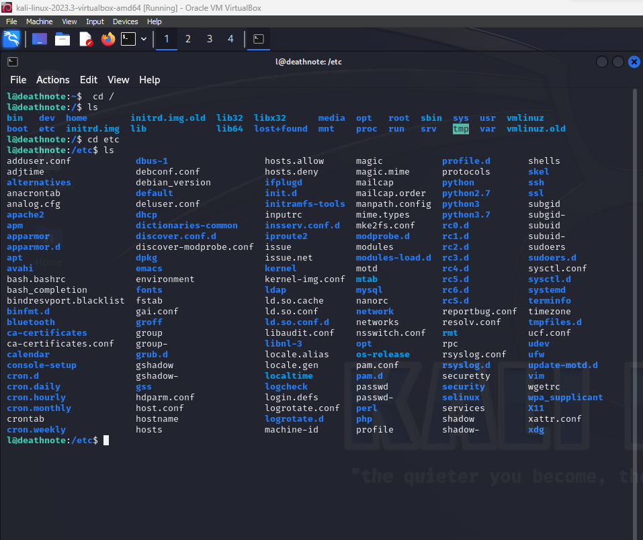
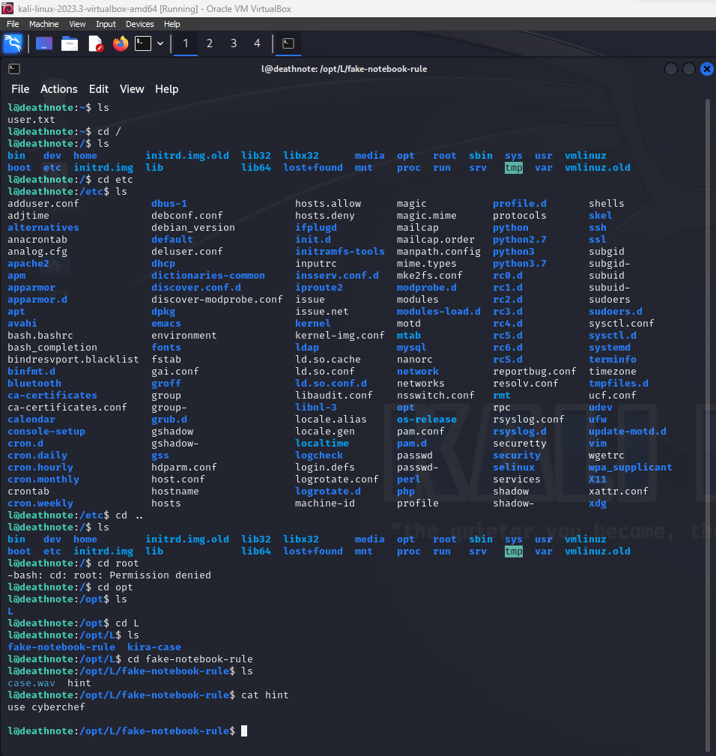
I spent a bit of time sifting through directories until coming to /opt and after navigating to /opt/L/fake-notebook-rule I was provided with a possibly encrypted root password in case.wav obtained when using the cat command and a hint to use cyberchef to decrypt.

Slide 10

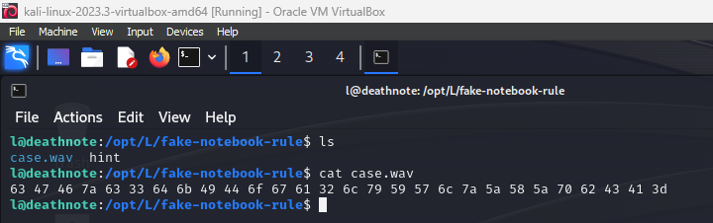
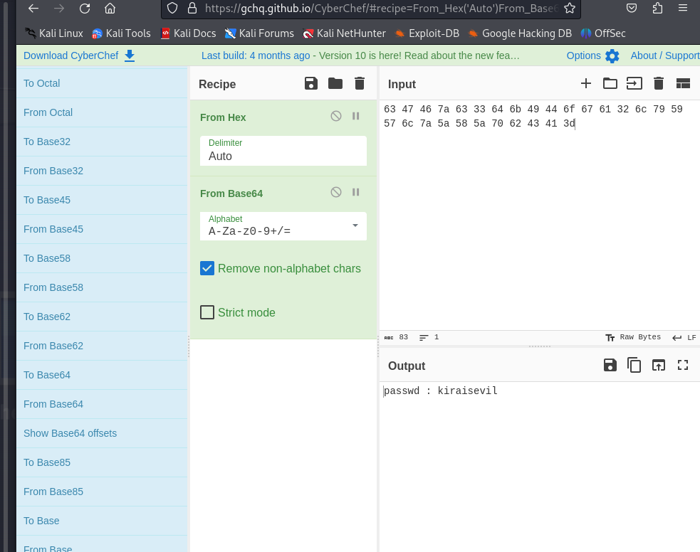
Case.wav was a Hex value and I decrypted it using cyberchef’s from hex value decryption which then gave me a base64 encryption the cyberchef portion of this vm took me a minute to find the proper recipe overall but when I found the correct recipe, I uncovered the root password kiraisevil.

Slide 11

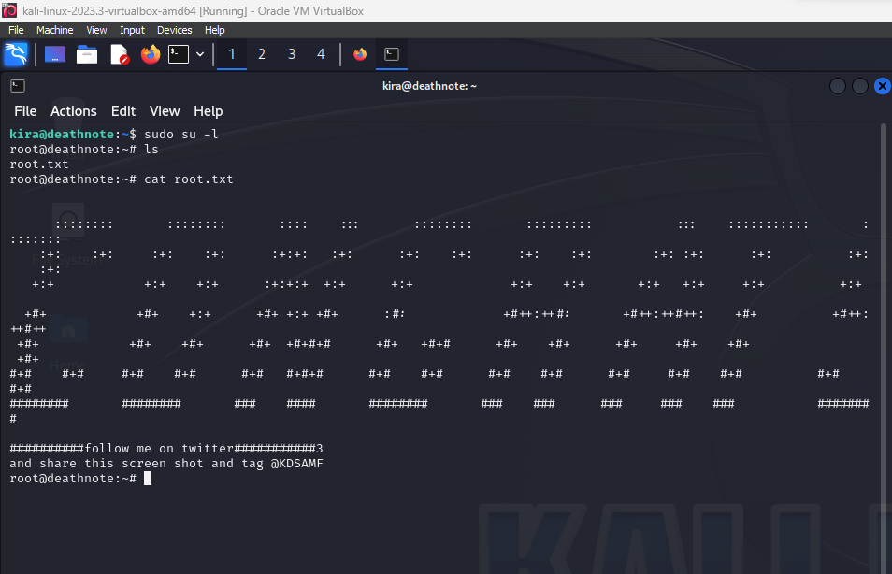
After obtaining the root password I logged into user kira and escalated to root and ran ls to locate the root.txt flag and completed the vm.

